Slide 1


Alan Turing: The Father of Artificial Intelligence
Alan Turing, born in 1912, was a brilliant English mathematician, computer scientist, logician, and cryptanalyst. He is widely regarded as the father of artificial intelligence and made groundbreaking contributions to the field of computer science. Turing's innovative work laid the foundation for modern computing and significantly influenced the development of artificial neural networks, a key component of modern AI systems.

Slide 2
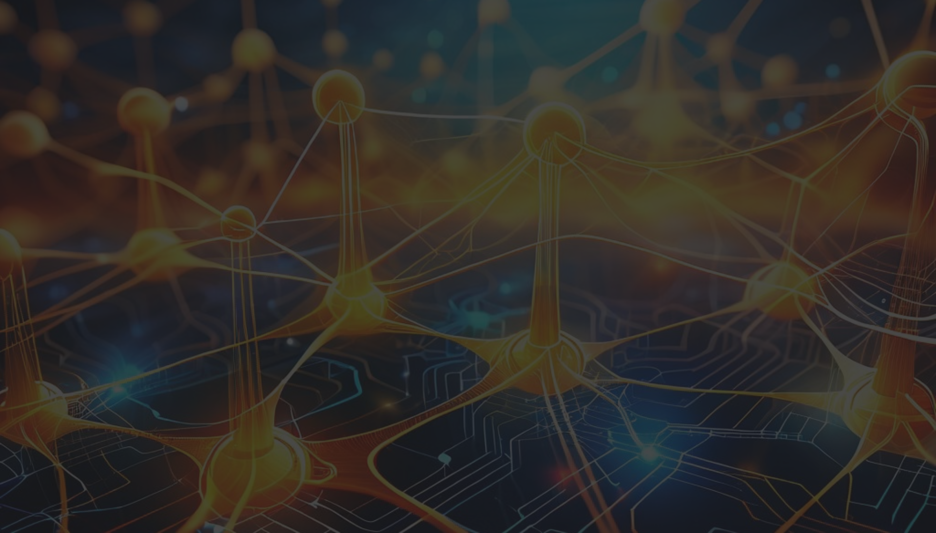
Turing's Groundbreaking Work on Artificial Neural Networks
Neural Networks and the Turing Machine
1
In 1936, Turing published his seminal paper on the "Turing machine," a theoretical model of computation that laid the groundwork for modern computer science. This work also inspired his exploration of artificial neural networks, which he saw as a way to mimic the brain's information processing capabilities.
2
The Turing Test and Machine Intelligence
Turing proposed the "Turing Test" in 1950, a thought experiment to determine whether a machine can exhibit intelligent behavior equivalent to a human. This test became a central concept in the field of artificial intelligence and continues to drive research on machine cognition and consciousness.
Pioneering Work in Neural Networks
3
In the 1940s, Turing began experimenting with artificial neural networks, designing early models that could learn and adapt. His work laid the foundation for the development of modern neural network architectures, which underpin many of the most advanced AI systems today.

Slide 3
The Legacy and Impact of Turing's Pioneering Contributions
Advancing Computer Science
Inspiring Artificial Intelligence
Influencing Cognitive Science
Turing's work on the Turing machine and his contributions to the field of computability theory laid the groundwork for the development of modern computers and programming languages. His ideas about the limits of computation and the nature of intelligence continue to shape our understanding of what machines can and cannot do.
Turing's visionary work on artificial neural networks and the Turing Test inspired generations of researchers and engineers to pursue the development of intelligent machines. His ideas about machine learning and the potential for artificial intelligence to match or even surpass human capabilities have been the driving force behind the rapid advancements in the field of AI.
Turing's work on the nature of intelligence and the possibility of machine consciousness has had a profound impact on the field of cognitive science. His ideas about the similarities and differences between human and machine cognition have been the subject of intense debate and research, leading to a deeper understanding of the human mind and its capabilities.

